Slide 1
THE TEN COMMANDMENTS OF INJECTION MOLDING

Slide 2
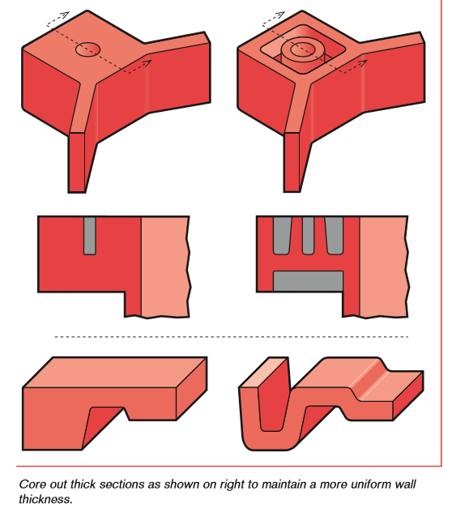
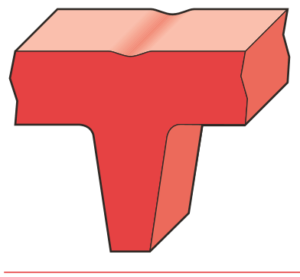
COMMANDMENT #1: UTILIZE CONSTANT WALL THICKNESS
Constant wall facilitates material flow – no eddying…
Facilitates cooling – thickest section dictates cooling time
2x wall = 6x to 8x cool time
Sink – materials shrink according to how thick they are
AVOID – thin to thick to thin (thick to thin okay, to a point…)
sink

Slide 3
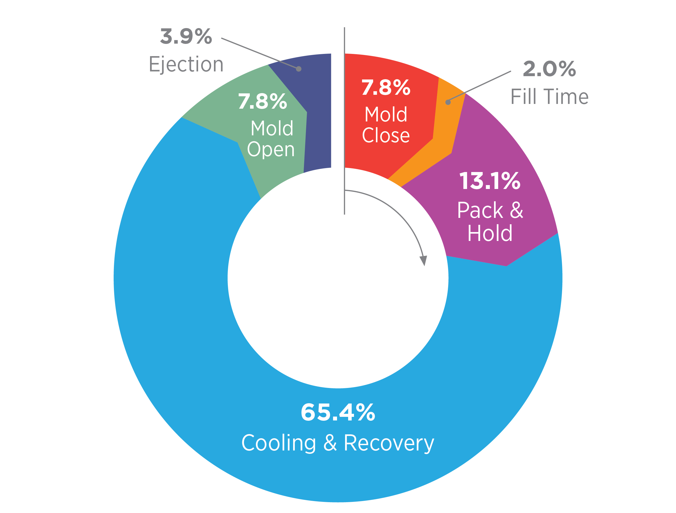
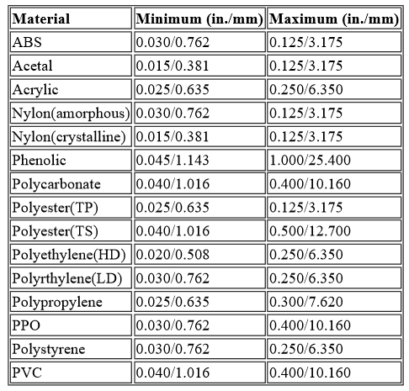
COMMANDMENT #1: UTILIZE CONSTANT WALL THICKNESS
CYCLE TIME- BASELINE
Depends on part / wall thickness – approx. 80% of the cycle time is cooling (pack/hold/cool/recover)
Wall thickness is second order to cycle time, and first order to weight
Cutting wall by 20% reduces weight by ~20%
Current wall by 20% reduces cycle by ~40%

Slide 4
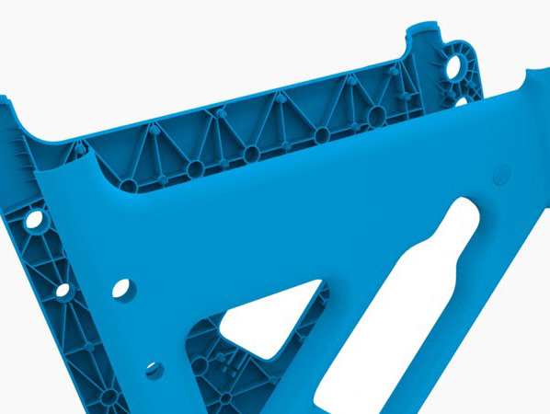
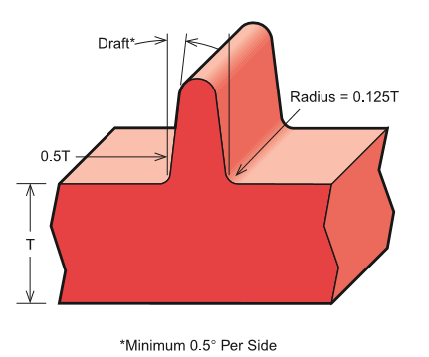
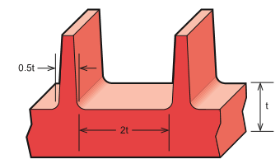
COMMANDMENT #2: UTILIZE RIBS AND BOSSES FOR STRUCTURE
Ribs add local structure
Height gives 3rd order increase in strength
Thickness at root should be 50% - 60% of nominal walls
Look for thin steel conditions (gap <2t)
Look for places where design is weak locally to reinforce with ribs
don’t overdesign/overcompensate!!

Slide 5
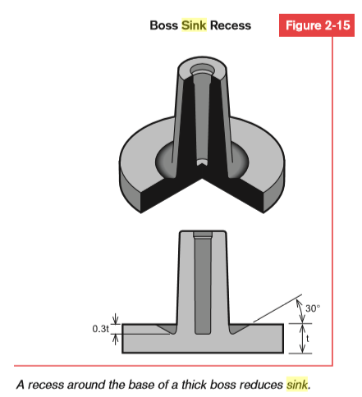
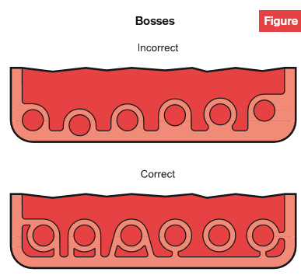
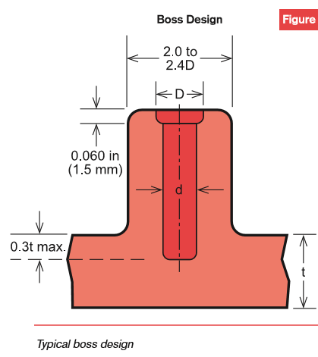
COMMANDMENT #2: UTILIZE RIBS AND BOSSES FOR STRUCTURE
Bosses add local structure
Great opportunity for sink if done poorly

Slide 6
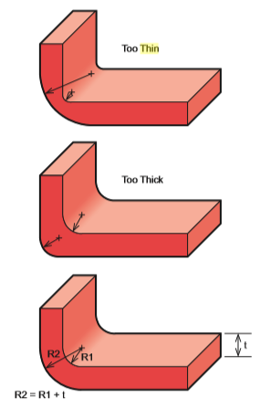
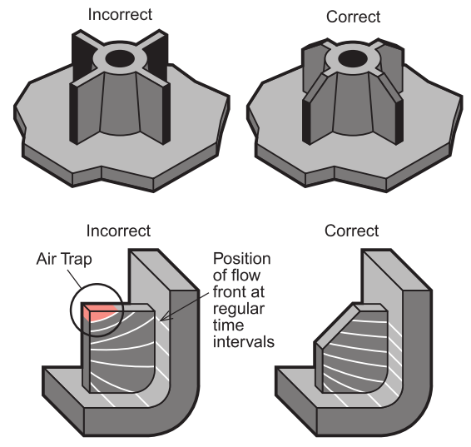
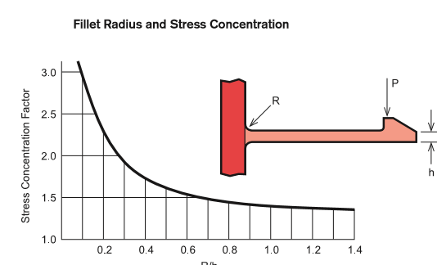
COMMANDMENT #3: AVOID SHARP CORNERS
AND TRANSITIONS
Outside radii should be no smaller than the smallest cutter from the machine shop (ask your moldbuilder)
Allows easier flow of material through mold
Radii reduce stress concentration in molded parts

Slide 7
COMMANDMENT #3: AVOID SHARP CORNERS
AND TRANSITIONS
What do sharp corners cause on molded parts?
Flow anomalies (eddying) will certainly occur
Stress concentrators
CNC cutters can’t make them in steel – must be (longer / more $)

Slide 8
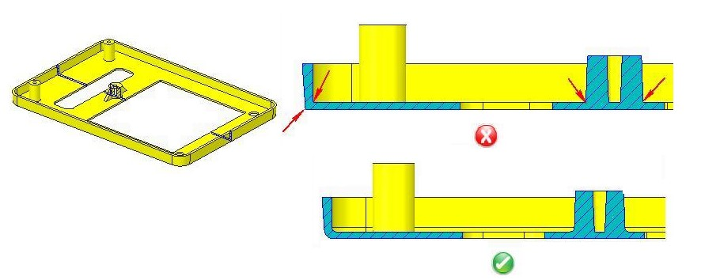
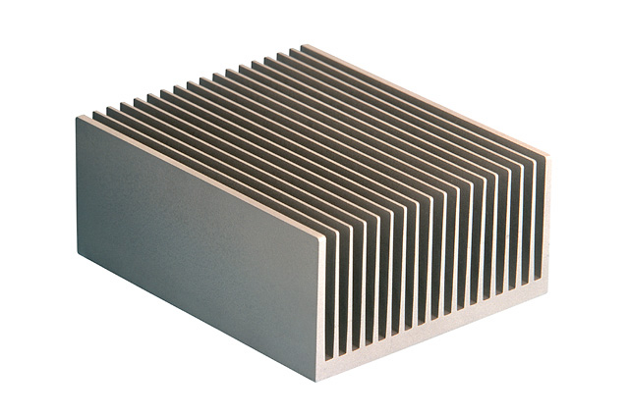
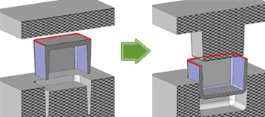
COMMANDMENT #4 – AVOID THIN SECTIONS / THIN STEEL
THIN STEEL / SECTION CONDITIONS
Forces of up to 18kpsi on a thin section – not good
Thin plastic sections are weaker
Thin steel sections / gaps are harder to machine

Slide 9
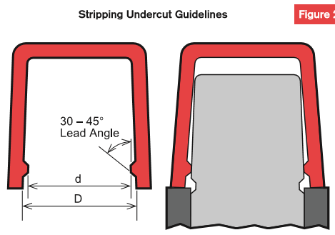
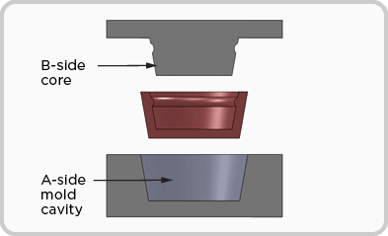
COMMANDMENT #5: AVOID UNDERCUTS / MOLD SIDE ACTION
BEWARE OF SIDE ACTION – BUT IF YOU MUST, MAKE THE PART MULTIFUNCTIONAL
Slides / hydraulic cylinders / horn pins - must move steel out of the way to clear for ejection
Adds cost / complexity / failure modes to the mold
Will cause premature wear
Adds cycle time – increased cost at part level!

Slide 10
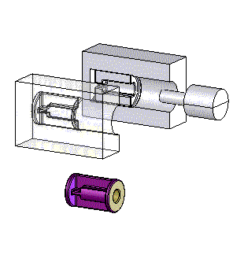
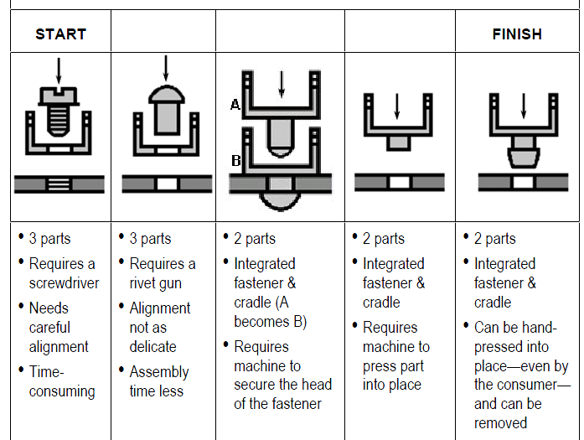
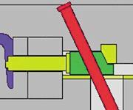
COMMANDMENT #5: AVOID UNDERCUTS / MOLD SIDE ACTION
BEWARE OF SIDE ACTION – BUT IF YOU MUST, MAKE THE PART MULTIFUNCTIONAL
A lot of drawbacks here…
Complicates mold
Increases mold cost
Decrease mold life
Increases cycle time
Increases press size, potentially
BUT
Might reduce number of parts, failure modes – DFMA!!
HORN PIN
HYDRAULIC / PNEUMATIC

Slide 11
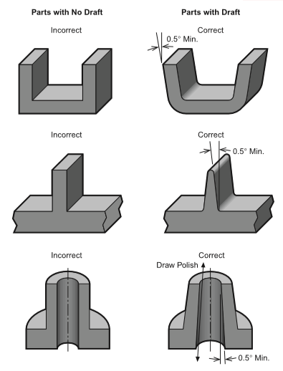
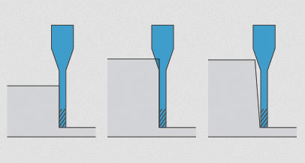
COMMANDMENT #6: USE ADEQUATE DRAFT
USE ADEQUATE DRAFT
Draft is taper that allows part to eject from mold
Varies depending on
Geometry
Texture
material

Slide 12
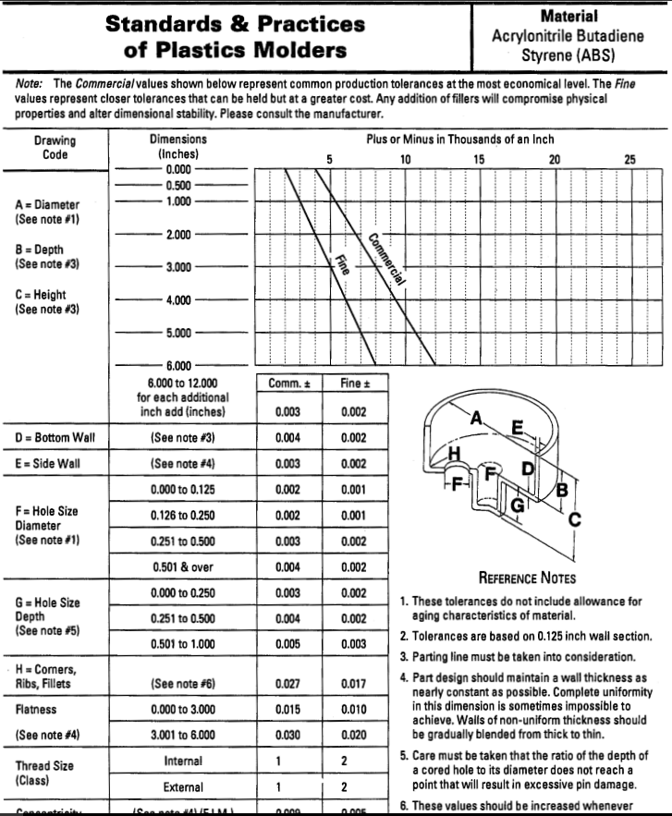
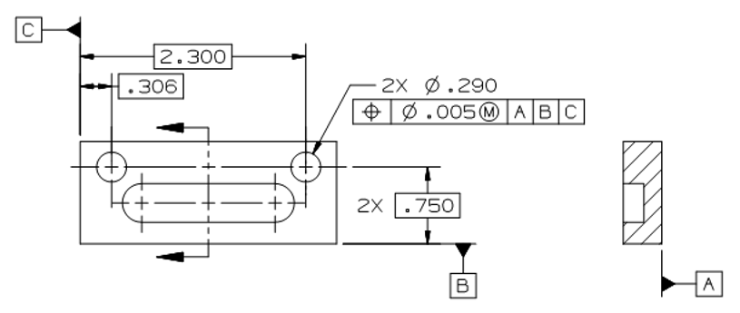
COMMANDMENT #7: TOLERANCE FOR PROCESS CAPABILITY
TOLERANCE FOR PROCESS CAPABILITY
Extremely tight tolerances add unnecessary cost, and in some cases preclude part from being manufactured
SPI (Society of the Plastics Industry - plastics trade organization) publishes tolerance charts for various dim types, by material, with graphs corresponding to nominal dim

Slide 13
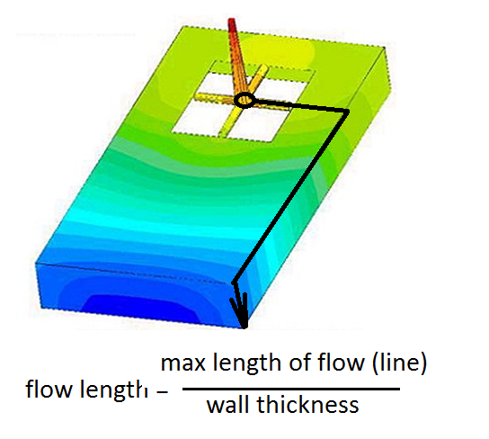
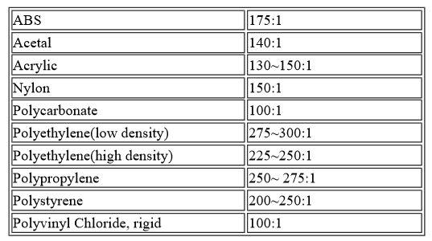
COMMANDMENT #8: USE SIMPLE CALCULATIONS AND
MOLDFLOW ANALYSIS TO PREDICT BEHAVIOR
UTILIZE FLOW RATIOS (FLOW PATH / THICKNESS)
Simple calculation to help ensure parts fill properly – lower is better
Do your best guess on path without MFA; ballpark is good enough
Refer to table below; if your FL is too high, either
thicken wall (bad)
add/move gates (better)

Slide 14
COMMANDMENT #8: USE SIMPLE CALCULATIONS AND
MOLDFLOW ANALYSIS TO PREDICT BEHAVIOR
USE MOLD FLOW ANALYSIS TO PREDICT FLOW PATTERNS
Can show locations of knit lines, air traps, potential short shots – based on selected locations / quantity of gates
Insight into molding pressure and cycle time – requiring design changes

Slide 15
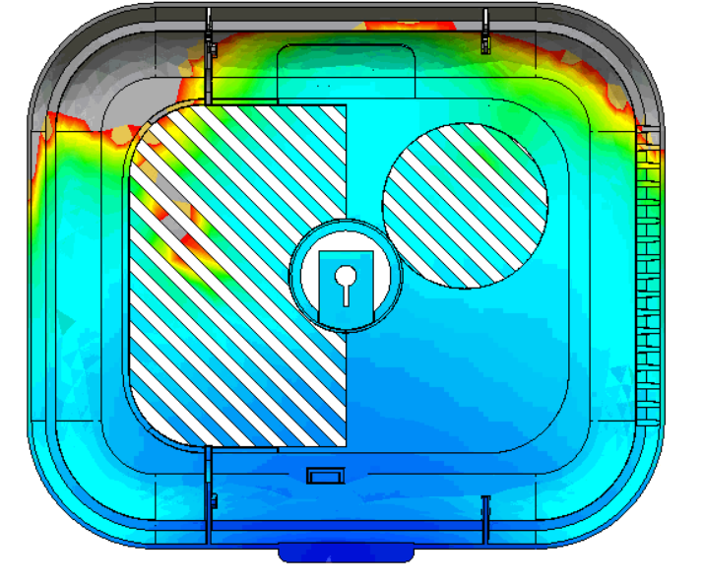
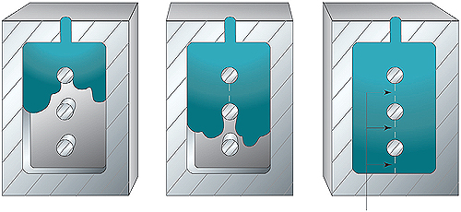
COMMANDMENT #9: BEWARE OF KNITS LINES
AND POTENTIAL SHORT SHOTS
KNIT LINES / SHORT SHOT
Knit Lines - The location where melt fronts come together
A function of gate location(s) and geometry
Approx. 75%-80% of the strength of the section right next to it
Cannot eliminate them!!!
Particularly an issue with translucent / clear parts
Short Shot – melt cools before full fill can be obtained
MFA can predict this relatively well
Weigh part and compare to 3D CAD weight

Slide 16
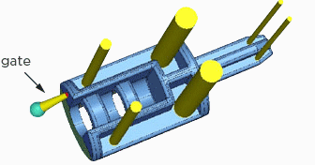
COMMANDMENT #10: OPTIMIZE GATE LOCATION / TYPE
TO REDUCE MOLDED IN STRESSES AT GATE
CONSIDER PEG – AND PROVIDE LOCATIONS IF NECESSARY (PADS)
Gate locations / type
Ejector Pin locations
Parting Line
EJECTOR PINS (YELLOW)

Slide 17
THE TEN COMMANDMENTS OF INJECTION MOLDING

